Slide 1
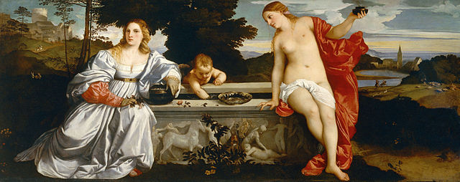
History 336
Ideas and Society in Early Modern Europe:
The Debate about Gender and Identity

Slide 2
History 336: Part 2
shift in class dynamics: from lecture to class discussion
preparation in Part 1: basic factual information
Part 2: build on Part 1 to listen to and interpret voices from the past

Slide 3
Office Hours for Week of 17 February
Monday, 18 February: 1 to 3 pm
office hour cancelled on Wednesday, 11:30-12:30
Regular office hours will resume the week of 24 February.

Slide 4
Who was Juan Luis Vives (1493-1540)?
native of Valencia, son of converso Jews
studied at the University of Paris (1509-1512)
active in England (taught philosophy at Oxford), Low Countries: (Leuven, Bruges)
Renaissance humanist
publications on education, poor relief, moral philosophy, peace

Slide 5
Who was Juan Luis Vives (1493-1540)?
Renaissance humanism
wisdom from antiquity
writers of ancient Greece and Rome, Christian antiquity: Bible, Church Fathers
languages: Greek, Latin, Hebrew
paradigm replacement of medieval scholasticism
main interests: grammar, rhetoric, poetry, moral philosophy, history
power of words: eloquence, philology
educational reform

Slide 6
Who was Juan Luis Vives (1493-1540)?
The Education of a Christian Woman (1524), revised in 1538
sixteenth-century translations: Spanish, English, Dutch, French, German, Italian
The Duty of a Husband (1529)

Slide 7
The training of virgins
Preface to Catherine of Aragon
Intellectual formation
Physical formation
Rhetoric and controversy
Rhetoric and religion

Slide 8
Questions for 4 February
What passages from the reading assigned for today strike you as historically significant?
What continuities exist between what you have read in The Education of a Christian Woman and what you have learned so far about women and gender in early modern Europe?
What is the most important virtue of a young woman? What is her worst vice?
Can you formulate at least one historical question based on the assigned reading to start a larger discussion?

Slide 9
Questions to consider for the rest of the course
What passages strike you as historically significant? Mark them and write them down.
What positions on women and gender does a given primary source take on women and gender? How does the author support these positions?
Can you formulate at least one historical question based on the assigned reading to start a larger discussion?
Can you find a few secondary sources (and other primary sources) by using the library catalogue and databases that will help you answer your historical question?
Can you think of any current news stories that relate to women and gender?

